Slide 1
Cycle GAN

Slide 2
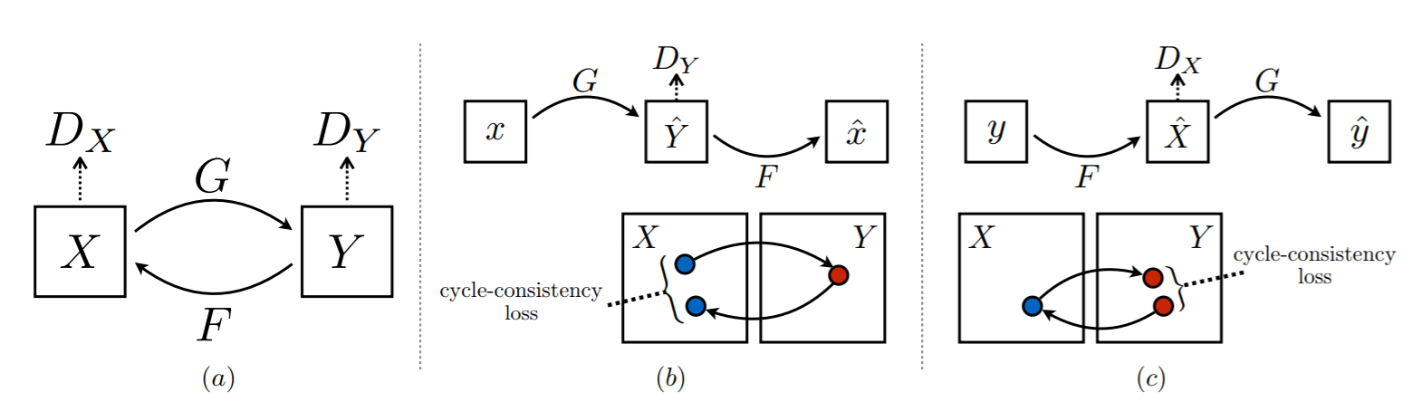

Slide 3


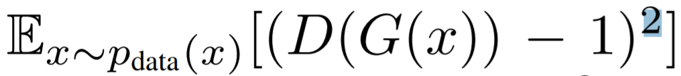
Adversarial Loss G: X -> Y
G x to y loss
D_y loss
Ls GAN
D minimize
G minimize

Slide 4
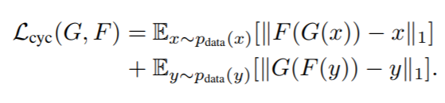
Cycle-consistency loss
L1 norm

Slide 5
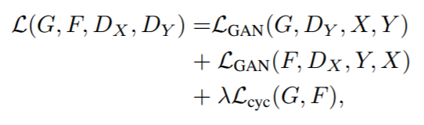
Full Objective

Slide 6
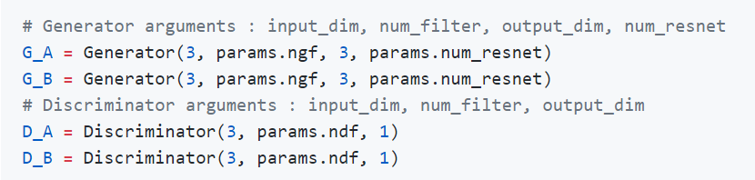
code
G,D 2개씩 사용
https://github.com/ratsgo/ratsgo.github.io/blob/master/_posts/2018-01-30-genmodels.md

Slide 7
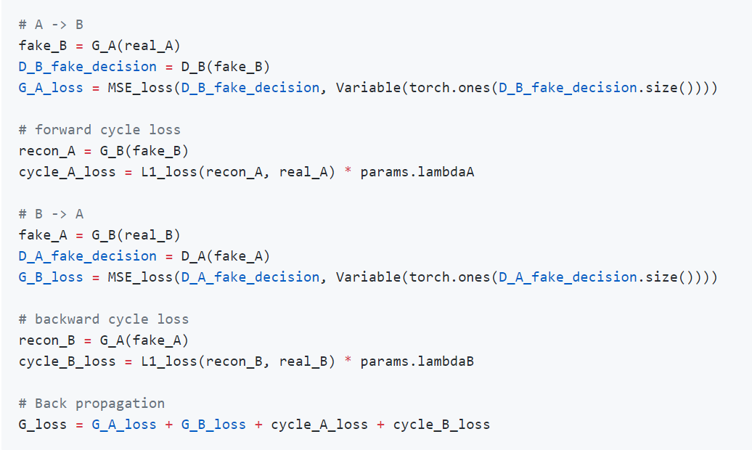
G_loss

Slide 8
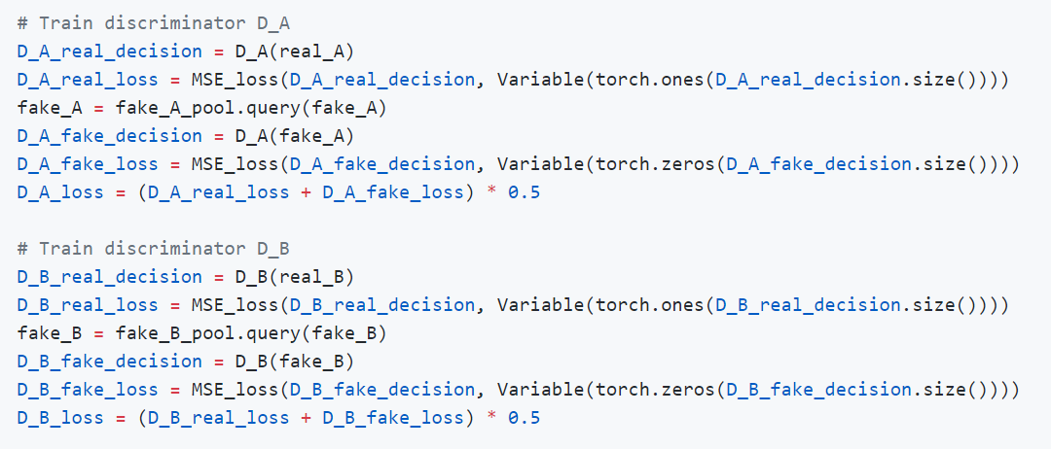
D_loss

